Slide 1
Debugging Algorithm to Localize Bugs in LeetCode Algorithm Challenges
By Orry Willems, Hayden Ernst

Slide 2
Motivation
Debugging, despite being very important, is difficult to do manually.
  Gets tougher and tougher the more lines there are.
Being able to localize bugs becomes quite handy!
  More reliable software
  Less time debugging, more time creating

Slide 3
Problem Statement
This project seeks to create a bug localization algorithm for Python.
Used a LinkedList addition program as example.

Slide 4
The Approach
Our algorithm happens in three parts. Given a buggy program & a set of expected test cases:
Collect data on which test case uses which line, for every line
Calculate a suspiciousness score for each individual line
Rank each line from most to least suspicious

Slide 5
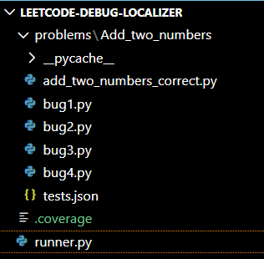
Methodology
Project structure is as seen on the right.
“runner.py” is main file.
  Traces & records executed lines
  Multiprocessing
Suspiciousness calculated using Ochiai Formula.
_____Fail(e)________
√(Fail(total) * (Fail(e) + Pass(e)))

Slide 6
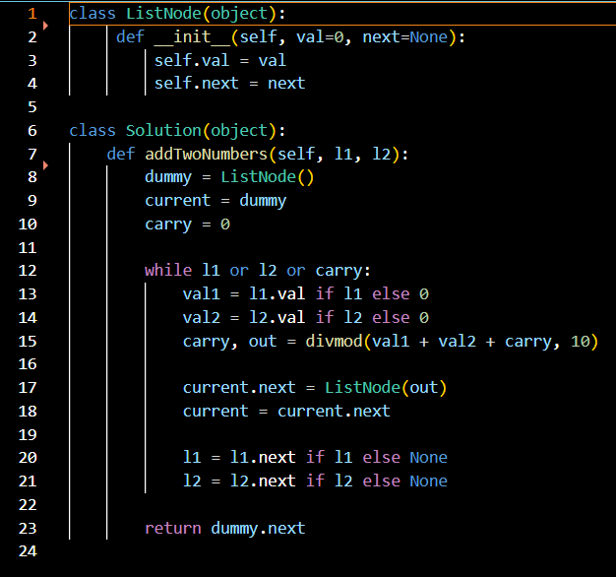
Tested Bugs
Correct code is as seen on the right.
Four different bug variants tested:
Multiplying val1 if >5
Duplicated Carry
Changed While Loop Condition
  while l1 and l2:
l1 = l1 if l1 else None
  Created infinite loop

Slide 7
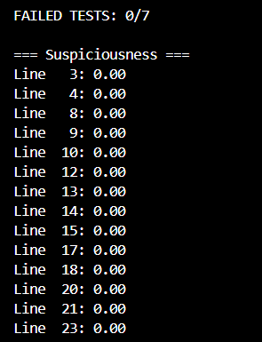
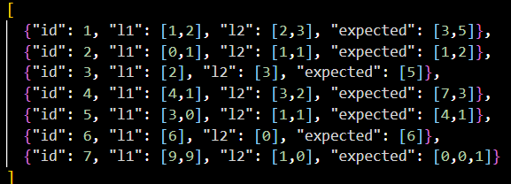
Results
Notes:
left: test cases | right: standard, nonbuggy code results

Slide 8
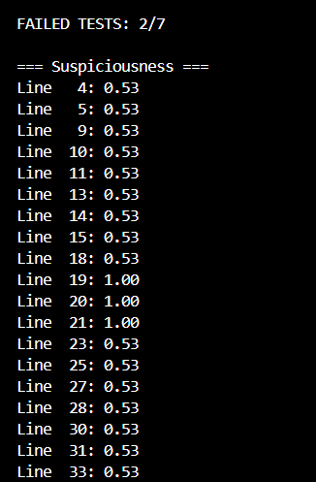
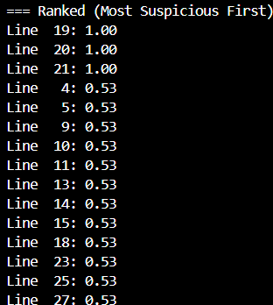
Notes:
bug1.py

Slide 9
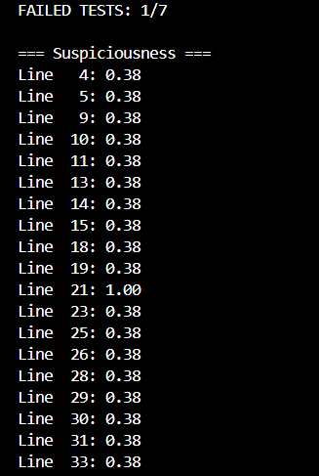
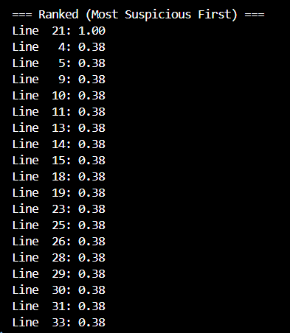
Notes:
bug2.py

Slide 10
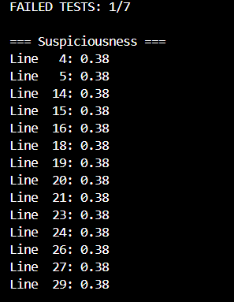
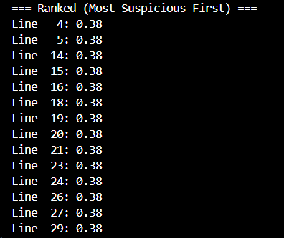
Notes:
bug3.py

Slide 11
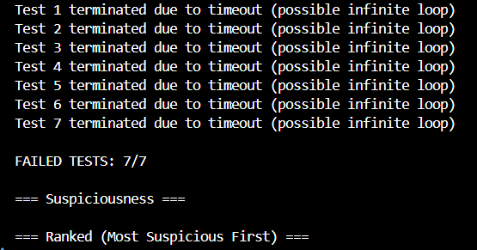
Notes:
bug4.py

Slide 12
Discussion
No particular bug types were very hidden
  Ochiai > Tarantula
Inherent difficulties with certain bug types
  Infinite loops need to be terminated, doesn’t allow for suspiciousness ranking
SBFL powerful, but has a few minor limitations
  Requires structure to be relatively the same between buggy program & solution
  Can’t find bugs which aren’t triggered by tests
  Requires tests

Slide 13
Conclusion
We have successfully made a bug localization debugging program.
  Able to accurately locate where bugs would be.
A few lessons learned
  Ochiai >>>> Tarantula
  SBFL generally has a pretty broad range
Possible improvements?
  More testing with more buggy programs
  More measures in place to account for more catastrophic failures

Slide 14
Any questions?

